Slide 1
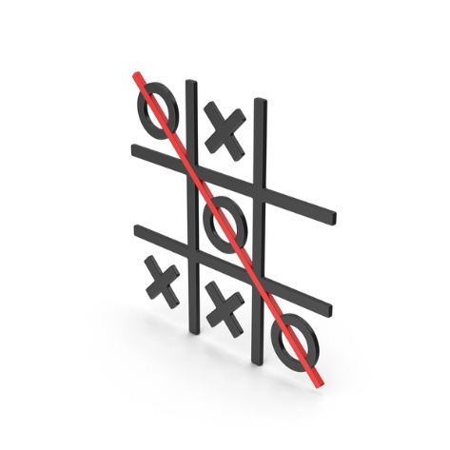
Developing a Tic Tac Toe AI Agent Using Minimax with Alpha-Beta Pruning
Team Members:
Priyanka Singh
Heli Sureja
Subject: Introduction to Artificial Intelligence
Under guidance of: Prof. Shivanjali Khare

Slide 2
Objective
Implement an AI that plays optimally in all Tic Tac Toe scenarios.
Reduce computation time using alpha-beta pruning.
Analyze performance against human and random agents.

Slide 3


Research Question & Methodology
Research Question:
Can an AI agent using Minimax with alpha-beta pruning consistently outperform random or human strategies in Tic Tac Toe?
Methodology:
Represent the game tree of all possible moves.
Use Minimax to simulate opponent behavior.
Use alpha-beta pruning to eliminate unnecessary branches.
Compare AI agent’s performance against human and random players.

Slide 4
Tools & Techniques
Programming Language: Python
Libraries/Frameworks:
pygame (for GUI-based game visualization)
time (for performance measurement)
random (for opponent simulation)
AI Technique:
Minimax algorithm
Alpha-beta pruning to optimize search

Slide 5

Deliverables
Python Code: Complete Tic Tac Toe game with AI opponent.
Project Report: Methodology, explanation, challenges, and results.
Demo Video: AI playing against a human and random bot.
Performance Charts: Win rates and response times.
GitHub Repository: Shared with instructor.

Slide 6

Evaluation Methodology
Success Metrics:
Win Rate: % of games won by the AI against random and human players.
Optimality: Ensure AI never loses a game.
Efficiency: Track average decision time with and without pruning.
Human Feedback: Evaluate challenge level from test users.

